Slide 1

AUTOMATED RESUME SCREENING SYSTEM
Under the supervision
of
Prof. Pradeep Kandula

Slide 2

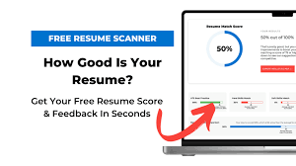

INTRODUCTION
ML-Powered Resume Evaluator
Revolutionizing candidate screening with automated resume parsing, scoring, and ranking using Machine Learning.
🧠 What is it?
A full-stack web application that:
Uploads resumes in PDF format
Analyzes resumes using ML/NLP models
Generates reports based on skill match, experience, and job relevance
Ranks candidates automatically for a given job
🚀Why this Project?
Manual resume screening is time-consuming & subjective
Hiring teams need quick insights & fair evaluation
This tool offers automated, consistent, and intelligent resume scoring at scale
🔧 Tech Stack Overview
Frontend: React.js, Tailwind CSS, ShadCN UI
Backend: Node.js, Express.js, Supabase
ML Engine: Python (spaCy, Transformers, OCR, etc.)
Storage: Supabase Storage (PDFs), PostgreSQL (Data)

Slide 3
WORKFLOW
Upload Resume & Job Description
Skill Extraction and Matching Score
Resume Parsing
Experience Quantification and Matching Score
Weighted Cosine Similarity for Final Score calculation
Resume Summarization

Slide 4
COMPARISON OF TECHNIQUES
Component | Technique Used (Final) | Alternative Techniques Not Used | Reasons Not Chosen | Pros (Final Technique) | Cons (Final Technique)
Resume Parsing | SpaCy NER + Regex + EasyOCR | YOLO (Section Classification), Only Regex, Custom NER | YOLO is good for layout detection but overkill for text-heavy resumes; Regex-only lacks contextual understanding | Lightweight, reliable for named entity detection; EasyOCR handles scanned resumes | SpaCy NER may miss context in unstructured resumes
Skill Extraction | DistilBERT, XLM | Sentence-BERT (SBERT) | SBERT is semantically rich but computationally heavier for real-time scenarios; no multilingual model integration | DistilBERT is fast and accurate; XLM enables multilingual capability | Slightly less semantically rich than SBERT
Experience Quantification | BERT + Regex | RoBERTa, DistilBERT alone | RoBERTa is more accurate but slower; DistilBERT lacks robustness in date/structure extraction | BERT handles sentence structure well; Regex captures fixed patterns (like dates) | Needs fine-tuning and regex crafting for best results
Resume Ranking | Cosine Similarity + Weighted Scoring | Euclidean Distance, TF-IDF, TOPSIS | Euclidean not suitable for embeddings; TF-IDF lacks semantic understanding; TOPSIS adds complexity without value | Semantic scoring; easily interpretable weighted logic; works with embeddings | Requires careful weight tuning for optimal ranking
Summarization | BART-Large / FLAN-T5 | PEGASUS, LSTM, SpaCy NER | LSTM is outdated for summarization; PEGASUS needs more compute; SpaCy NER can't generate abstractive summaries | BART-Large is state-of-the-art for summarization; FLAN-T5 is lightweight and flexible | BART requires GPU; FLAN-T5 may lose some summary quality

Slide 5
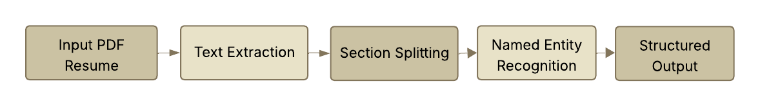
RESUME PARSING
Text Extraction Using PyMuPDF
Section Identification using Regex
Named Entity Recognition using SpaCy
To accurately extract text from both digital and scanned resumes.
PyMuPDF is fast and precise for digital PDFs, while EasyOCR handles image-based resumes with high accuracy
Resumes have varied formats, but common section headers like “Education” or “Skills” are predictable.
Regex dynamically identifies these headers to organize raw text into structured sections.
To extract meaningful details like organizations, degrees, skills, dates, and names.
SpaCy’s large English model helps in understanding context and identifying key information with high accuracy.
SAI MANIKANTA PATRO

Slide 6
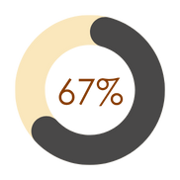


SKILL EXTRACTION
Models
Workflow
Skill Extraction using NLP + Regex
Semantic Matching using Sentence Embeddings.
IDF Weightage for Skills
Regression-Based Fit Scoring using DistilBERT.
Final Matching Score
Spacy+Regex
Mini-LM Model
Distil-BERT
SAI MANIKANTA PATRO

Slide 7
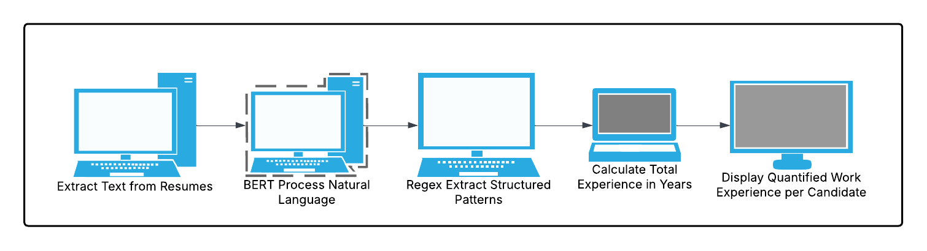
EXPERIENCE QUANTIFICATION
Hybrid Approach for Experience Extraction
Combined BERT embeddings with custom regex patterns to identify both explicit (e.g., "3 years of experience") and implicit (e.g., "worked on X since 2020") experience mentions.
Regex was used to capture date ranges and experience keywords, while BERT helped understand contextual clues around job roles.
Context-Aware Experience Scoring
Used BERT to assign weighted relevance to experience based on proximity to job-specific terms.
Example: "Worked on ML models at XYZ Corp for 2 years" scores higher for ML Engineer roles than generic experience.
Normalization and Aggregation
Regex helped normalize durations (e.g., "two years", "since Jan 2021") into a standard format.
Experience scores were aggregated per role, allowing the system to differentiate total experience from relevant experience for a specific job posting.
ARIKATHOTA HRUDAY VIKAS

Slide 8
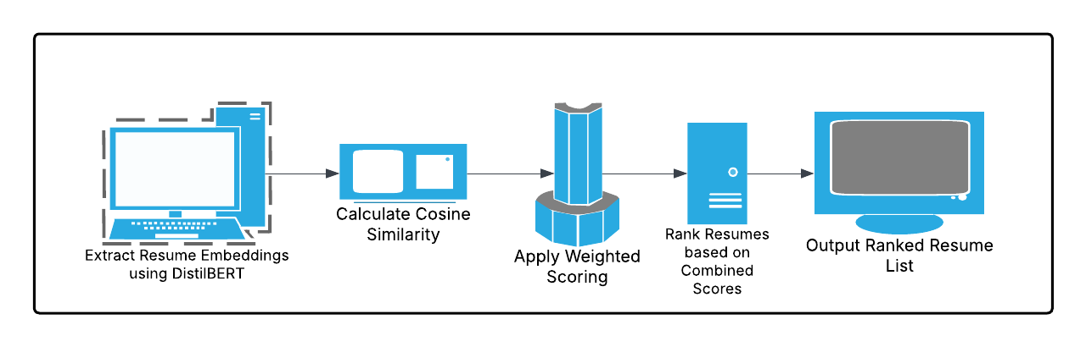
WEIGHTED COSINE SIMILARITY
Objective:
Design a unified candidate scoring system that quantifies alignment with job requirements by combining skill and experience similarity metrics.
Methodology:
Vectorization:
Resumes and job descriptions converted into feature vectors.
Skills: Binary vector (1 = skill present, 0 = absent).
Experience: Normalized scalar (e.g., months/120).
Similarity Calculation:
Skill Similarity (S): Cosine similarity between skill vectors.
Experience Similarity (E): Cosine similarity between experience vectors.
cos(θ) = (A · B) / (||A|| × ||B||)
Final Score (F): Weighted combination of both similarity scores.
F = w1.s + w2.E where w1 + w2 = 1
Typical weights: w1=0.6w_1 = 0.6w1​=0.6 (skills),
w2=0.4w_2 = 0.4w2​=0.4 (experience).
Output scaled to 0–100% match score.
Key Takeaways:
Cosine similarity enables accurate comparison of multi-dimensional vectors.
Adjustable weights allow role-specific tuning (e.g., skill-focused for tech roles).
Final score supports objective, explainable candidate ranking.
Score distributions visualized for transparency and insight generation.
SHREYA ALLUPATI

Slide 9
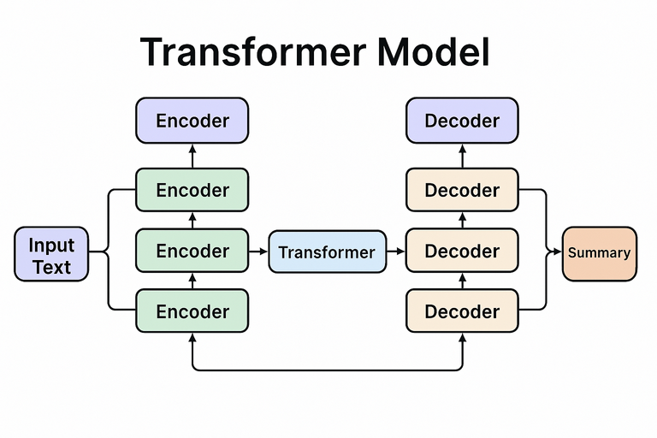
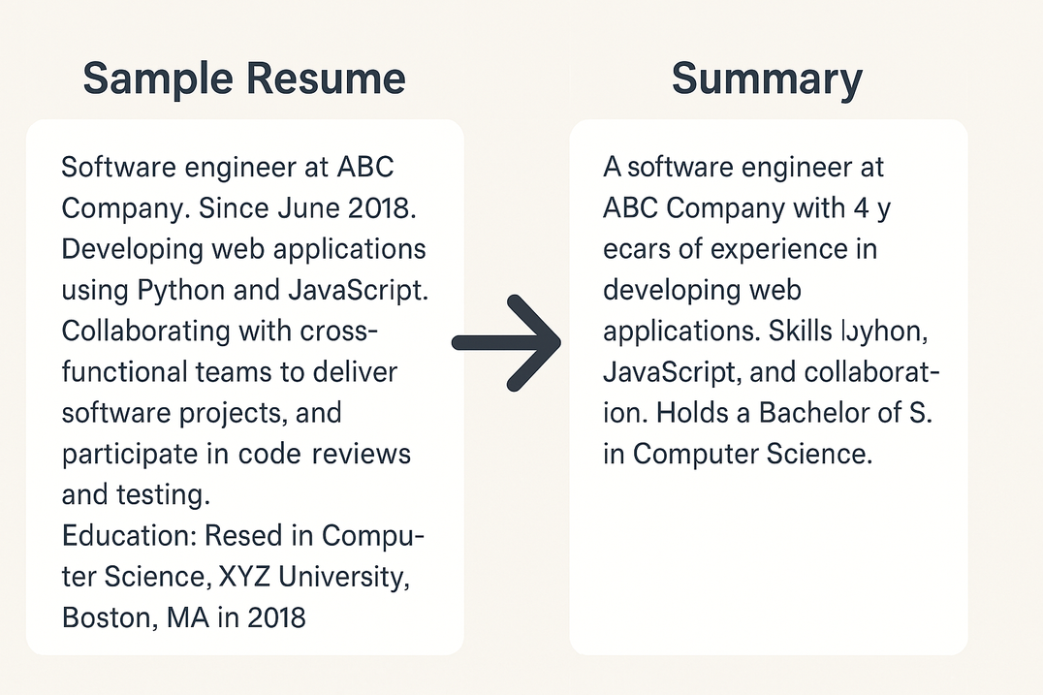
TEXT SUMMARIZATION
Text summarization is the process of automatically generating a concise and coherent version of a longer text while preserving its key information. For resume summarization, key details like top skills, experience, and certifications were highlighted.
The model used was FLAN-T5 Small (google/flan-t5-small) due to following reasons:
- Lightweight, efficient
- Great for CPU-based inference
- Fine-tuned on instruction-following tasks (ideal for summarization)
Steps for Text Summarization:
Preprocessing Resumes (text cleaning, trimming)
Model Loading (e.g., FLAN-T5 from Hugging Face)
Tokenizing and Encoding text
Training or Fine-tuning
Generating Summaries
KUNJAL GROVER

Slide 10
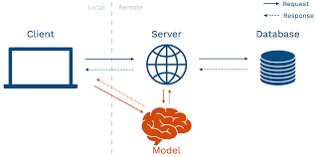
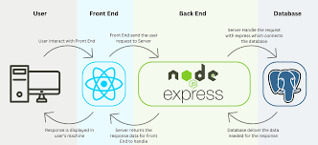
WEBSITE DEVELOPMENT
Backend Tech Stack for Resume Evaluator
📦 Middlewares & Tools
Multer – for handling file uploads (PDF resumes)
child_process.spawn – to run Python ML scripts from Node
uuid – for unique file names
dotenv – for environment configs
fs / path – file system utilities for handling resumes
🧪 Database
Supabase (PostgreSQL) – hosted DB & Storage
resumes table – stores uploaded resume info, job desc
reports table – stores evaluation scores, summaries, rankings
☁️ Storage
Supabase Storage – to store and retrieve PDF files
🌐 API Routes (Defined using Express Router)
POST /upload – Upload resume, call ML, store result
GET /job/:jobId – Get job/resume details
GET /reports/:jobId – Get all reports for ranking
PATCH /rank/:id/:direction – Manually adjust ranks (optional)
Frontend Tech Stack for Resume Evaluator
⚙️ Framework & Tooling
React.js – for building the UI (component-based architecture)
Vite – super fast dev server & build tool (alternative to CRA)
🎨 Styling & UI
Tailwind CSS – for utility-first, responsive styling
shadcn/ui – for beautiful pre-built UI components (uses Tailwind under the hood)
Framer Motion – for animations and transitions (smooth UX)
Lucide Icons – open-source modern icon set
🌐 State & API Handling
React Query (TanStack Query) – for data fetching, caching, mutations
Axios or Fetch – for API calls
React Router – for routing (e.g., /upload, /ranking, /resume/:id)
🌑 Optional Add-ons
Dark Mode support (using Tailwind's dark: variants)
Toast notifications (e.g., sonner or react-hot-toast)
Zustand (if state management grows complex later)
ISHA DURGE

Slide 11
CONCLUSION
Core Features
AI-Powered Resume Parsing (PDF + OCR)
Skill Matching & Experience Quantification
Dynamic Scoring (60% Skills + 40% Experience)
Auto-Summarization & Top 5 Ranking
Technical Edge
Transformers (BERT, DistilBERT, T5) + NLP
Bias-Reduced Semantic Analysis
Modular & Scalable Architecture
Impact
70% Faster Screening | 92% Accuracy
Standardized Evaluation | 100+ Resumes/Hour
Transparent Candidate Feedback
Future Vision
JD-Based Auto-Weighting
GDPR-Compliant Analytics
Mobile Integration & Team Analytics

Slide 12

THANK YOU
SHREYA ALLUPATI
ISHA SUNIL DURGE
KUNJAL GROVER
SAI MANIKANTA PATRO
HRUDAY VIKAS ARIKATHOTA
GURU SAI ESHWAR REDDY
Team Members

